Slide 1
Bitstream Generation & FPGA Configuration
SHAKTI Group | CSE Dept | PS-CDISHA - RISE LAB
IIT Madras

Slide 2
Webinar Schedule
1. | Introduction
2. | Recap of Tool Setup
3. | Flow of Bitstream/MCS Generation and Board Configuration
4. | TCL-based Bitstream & MCS Generation and Configuration
5. | FPGA Configuration: Pre-built Bitstream and MCS Files
6. | FPGA Configuration: Bitstream & MCS via Vivado GUI
7. | FPGA Configuration: Status Check
shakti.org.in
‹#›

Slide 3
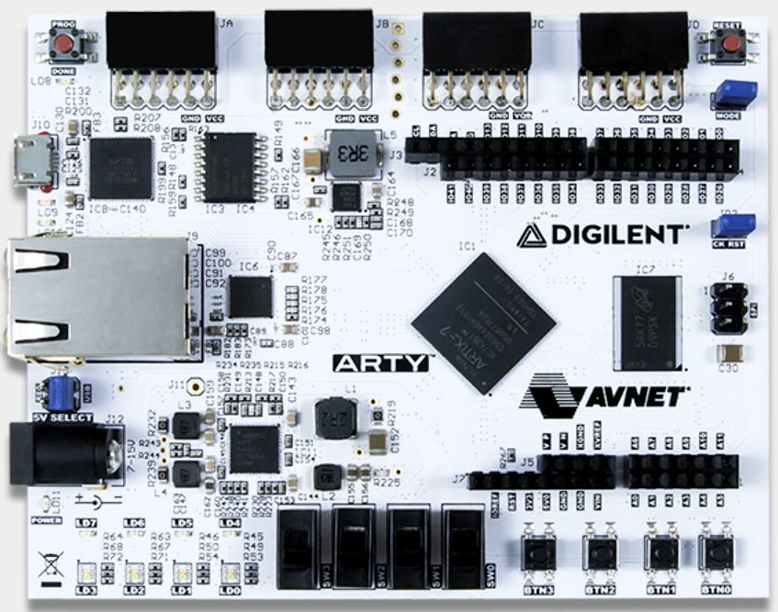
Introduction
Reconfigurable IC’s
Bitstream File
    Volatile, Reset, Program
    Approx ~6 seconds
MCS File (Memory Configuration Storage)
    Non-Volatile 128Mb QSPI Flash Memory
    Approx 4 - 5 Minutes
Generating Bitstream & MCS
Configuring Bitstream &MCS
Ensuring the tool setup is complete is essential before generating these binary files.
ARTY_A7_100T FPGA Board
https://digilent.com/reference/programmable-logic/arty-a7/start
shakti.org.in
‹#›
Notes:
FPGAs are reconfigurable integrated circuits enabling flexible hardware design.
This ability to reprogram and implement multiple SoC architectures on the same FPGA highlights its unique reconfigurable nature.
FPGA configuration requires binary files that describe the hardware setup.

Slide 4
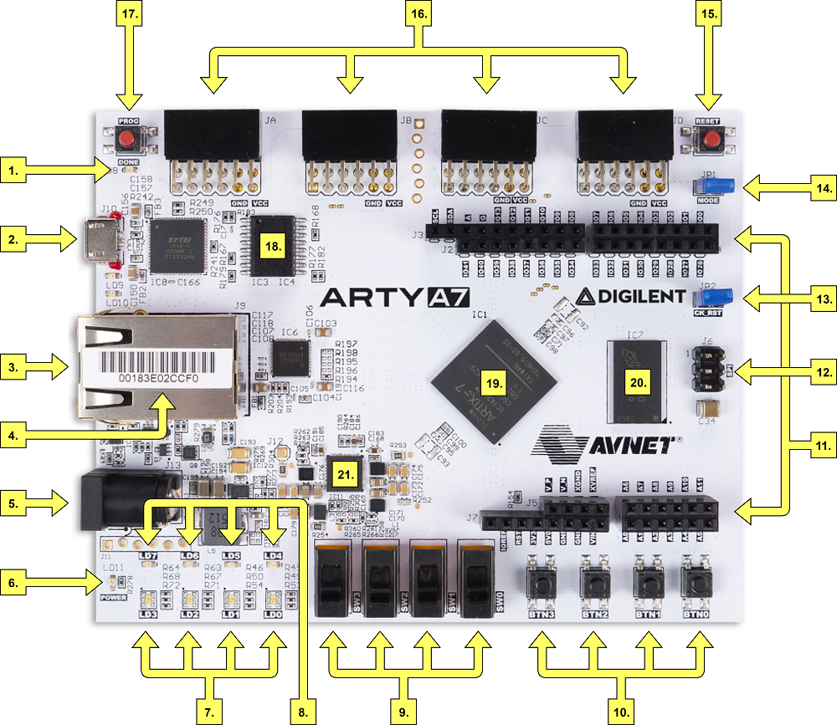
FPGA Configuration: Bitstream & MCS
Bitstream
    Volatile, Reset, Program
    Approx ~6 seconds
MCS
    Non-Volatile 128Mb Serial Flash Memory
    X4 SPI
    Approx 4 - 5 Minutes
Configuring ARTY A7 100T FPGA Board either in two ways:
    JTAG Configuration (J10 USB - JTAG)
    Quad-SPI Configuration
reference:programmable-logic:arty-a7:arty-a7-callout.png
‹#›
shakti.org.in

Slide 5
Recap of Tool Setup
Make sure all the hardware and software dependencies should installed (Tool Setup Manual) before bitstream and mcs generation
Clone the gc2025 repo from the shakti gitlab by using the following link
    https://gitlab.com/shaktiproject/gc2025.git
shakti.org.in
‹#›

Slide 6
Flow of Bitstream/MCS Generation and Board Configuration
GC2025
Ganga Soc
Yamuna Soc
Generating Bitstream & MCS
ARTY A7 100T FPGA Board
Pre-Build
TCL Script
Configuring Bitstream & MCS
ARTY A7 100T FPGA Board
Vivado GUI
Makefile / Terminal Commands
shakti.org.in
‹#›

Slide 7
TCL-based Bitstream & MCS Generation
SHAKTI uses Makefile and TCL scripts to generate bitstream and MCS files for target FPGA boards.
Follow the steps to generate bitstream and mcs for the target fpga board
    Open the Ubuntu terminal and navigate to the gc2025/hw directory.
    Refer to the README.md file in the hw folder or the document “Bitstream/MCS Generation and FPGA Target Configuration.doc” for exact commands to build bitstream and MCS files.
For Ganga SoC
    make build BOARD=arty_a7_ganga
For Yamuna SoC
    make build BOARD=arty_a7_yamuna XLEN_build=32
shakti.org.in
‹#›

Slide 8
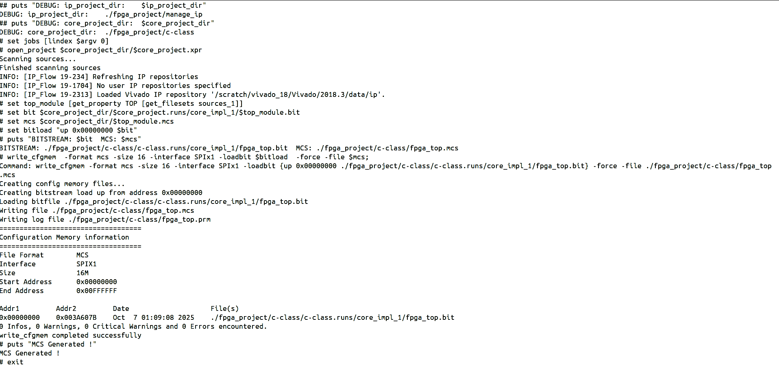
TCL-based Bitstream & MCS Generation
After successfully generating the bitstream and MCS files, the terminal displays a success message confirming the creation of both files.
shakti.org.in
‹#›

Slide 9
TCL-based Bitstream & MCS Configuration
Follow the TCL-based steps to load/configure bitstream (or) mcs for the target fpga board
    Open the Ubuntu terminal and navigate to the gc2025/hw directory.
    Refer to the README.md file in the hw folder or the document “Bitstream/MCS Generation and FPGA Target Configuration.doc” for the correct makefile or terminal commands.
Configuring MCS for Ganga SoC
    make program_mcs BOARD=arty_a7_ganga
Configuring Bitstream for Ganga SoC
    make program_bitstream BOARD=arty_a7_ganga
Configuring MCS for Yamuna SoC
    make program_mcs BOARD=arty_a7_yamuna
Configuring Bitstream for Yamuna SoC
    make program_bitstream BOARD=arty_a7_yamuna
shakti.org.in
‹#›

Slide 10
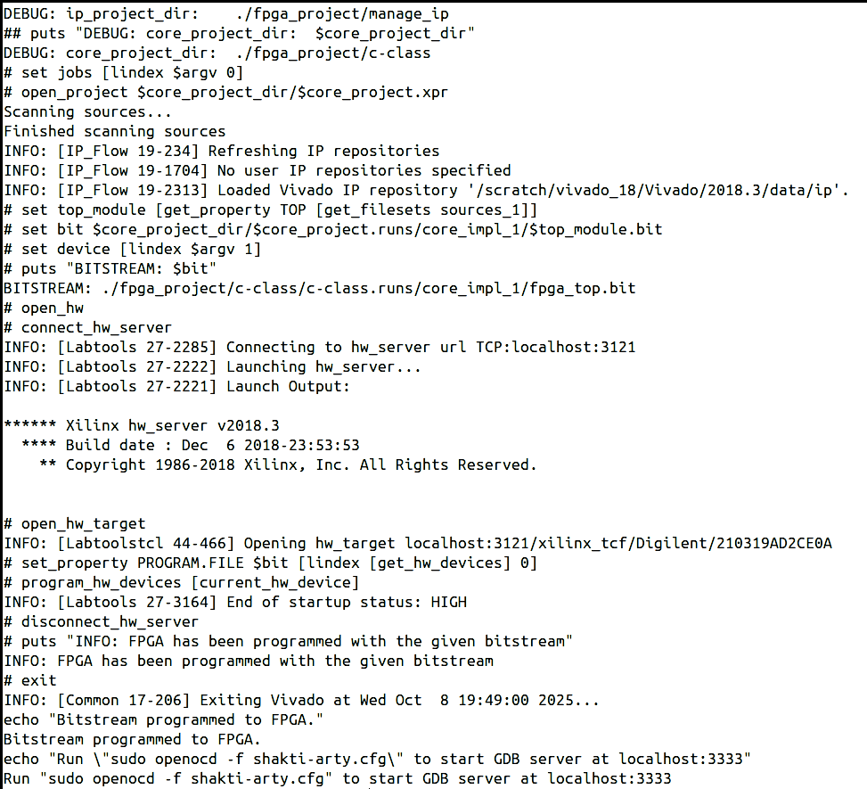
TCL-based Bitstream Configuration
Configuring Bitstream for Ganga SoC
    make program_bitstream BOARD=arty_a7_ganga
Configuring Bitstream for Yamuna SoC
    make program_bitstream BOARD=arty_a7_yamuna
shakti.org.in
‹#›

Slide 11
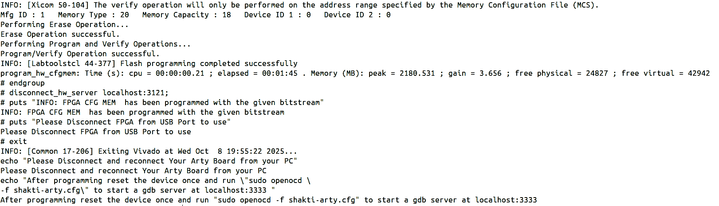
TCL-based MCS Configuration
Configuring MCS for Ganga SoC
    make program_mcs BOARD=arty_a7_ganga
Configuring MCS for Yamuna SoC
    make program_mcs BOARD=arty_a7_yamuna
shakti.org.in
‹#›

Slide 12
FPGA Configuration: Pre-built Bitstream and MCS Files
GCSDK
gc2025
hw
fpga_top.bit
Ganga
fpga_top.mcs
mcs
fpga_top.bit
Yamuna
fpga_top.mcs
shakti.org.in
‹#›

Slide 13
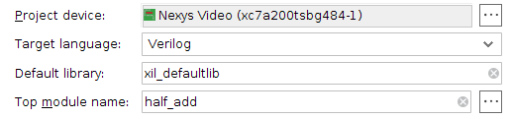
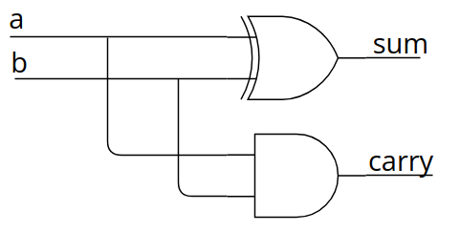
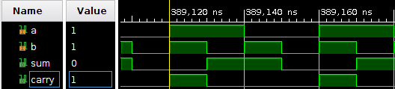
Recap of FPGA Design Flow and Step by Step Walkthrough the Target FPGA Board.
1. Design Entry - HDL Coding
(Verilog or VHDL or System Verilog)
module half_add (
input a,b,
output sum,carry
);
assign sum = a ^ b;
assign carry = a & b;
endmodule
3. Project Device
(Board Selection)
4. Constraints (Xilinx Design Constraints)
## Switches
set_property -dict { PACKAGE_PIN E22 IOSTANDARD LVCMOS12 } [get_ports { a }]; #sw[0]
set_property -dict { PACKAGE_PIN F21 IOSTANDARD LVCMOS12 } [get_ports { b }]; #sw[1]
## LEDs
set_property -dict { PACKAGE_PIN T14 IOSTANDARD LVCMOS25 } [get_ports { sum }]; #led[0]
set_property -dict { PACKAGE_PIN T15 IOSTANDARD LVCMOS25 } [get_ports { carry }]; #led[1]
2. Behavioral Simulation
‹#›

Slide 14
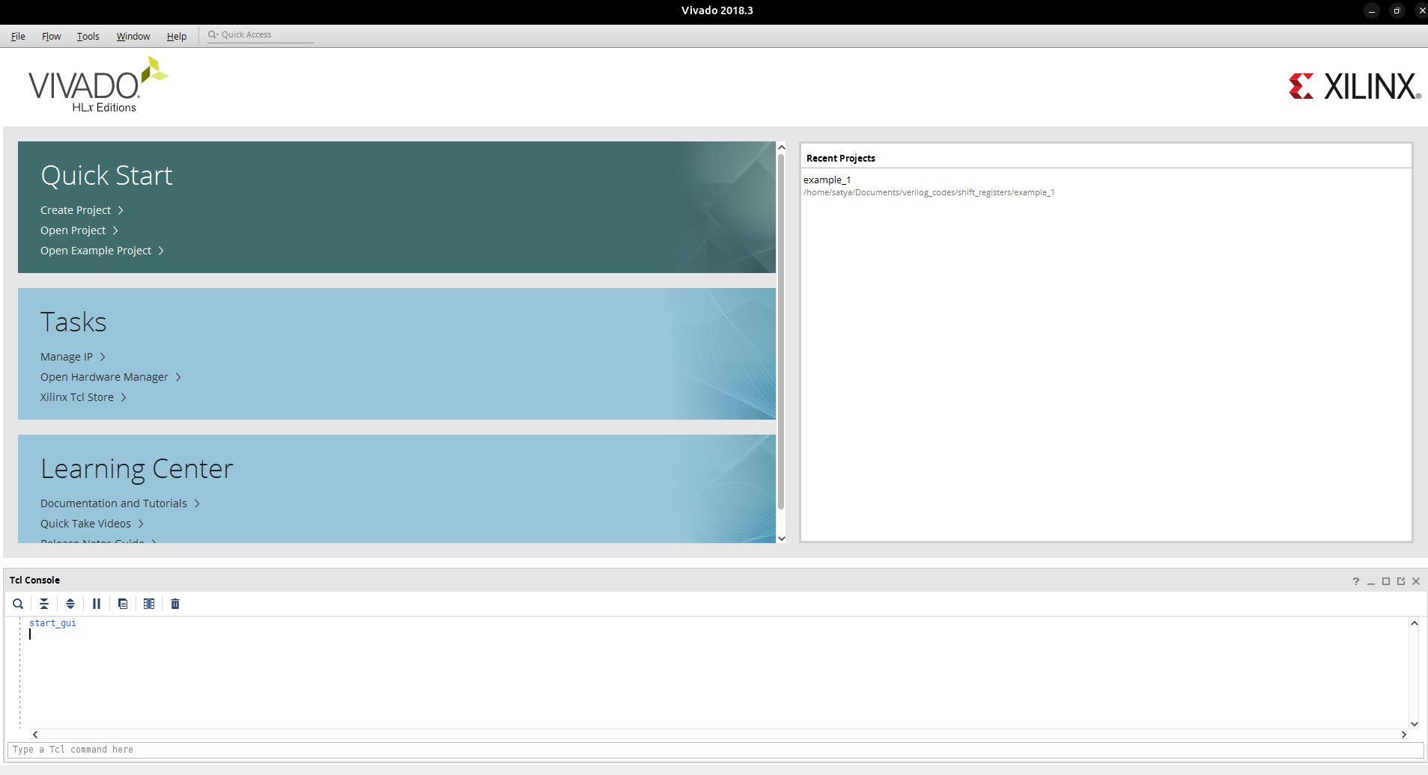
FPGA Configuration: Loading Bitstream via Vivado GUI
shakti.org.in
‹#›

Slide 15
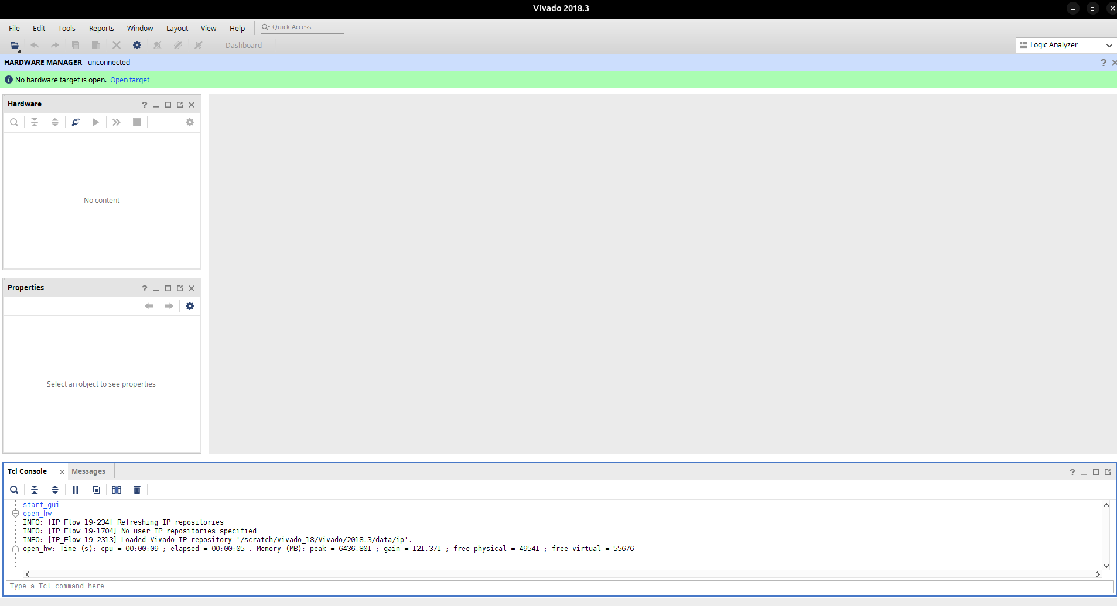
FPGA Configuration: Loading Bitstream via Vivado GUI
Auto Connect
shakti.org.in
‹#›

Slide 16
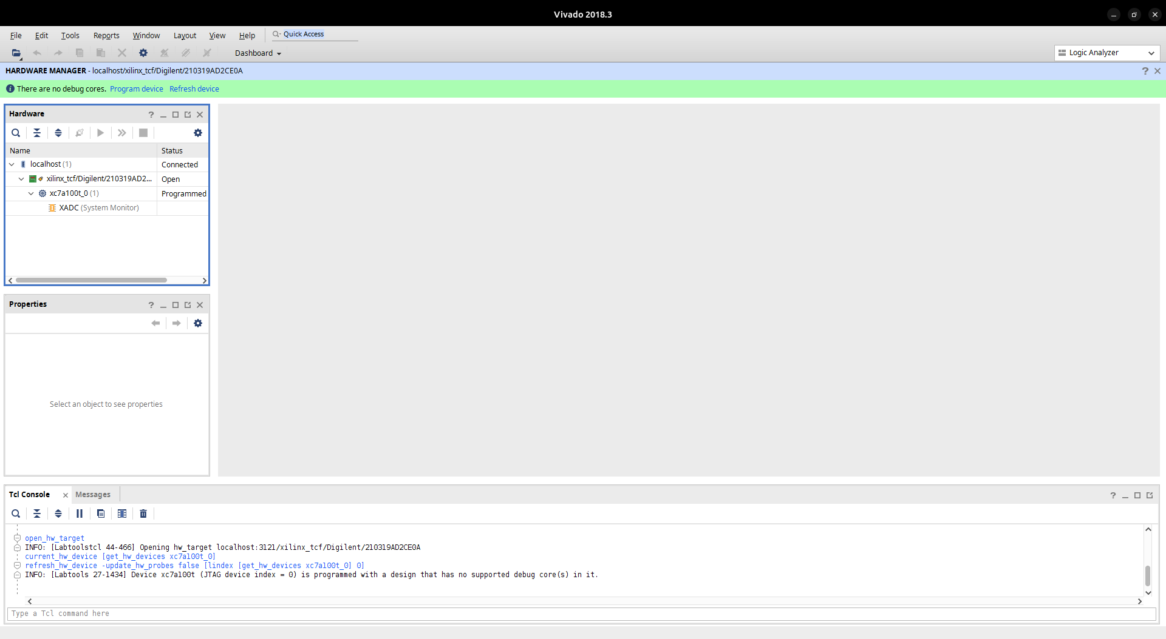
FPGA Configuration: Loading Bitstream via Vivado GUI
shakti.org.in
‹#›

Slide 17
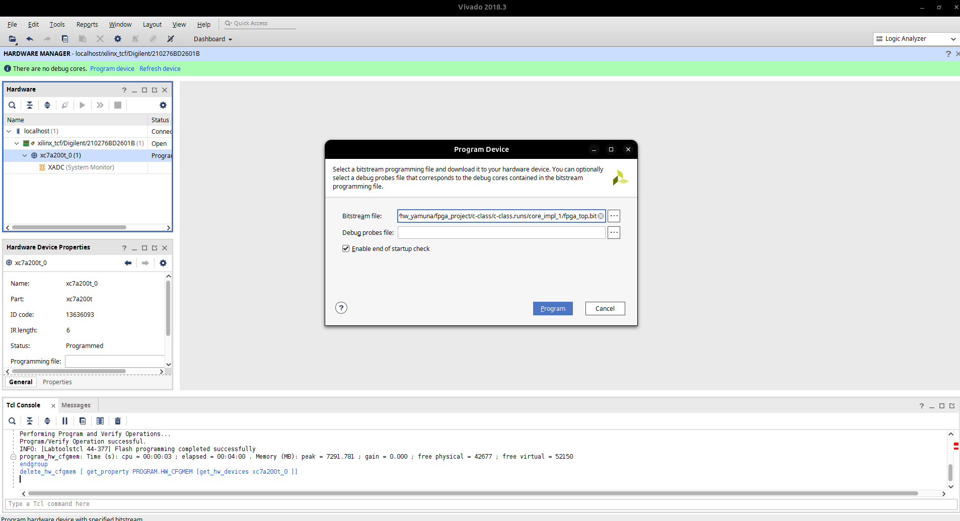
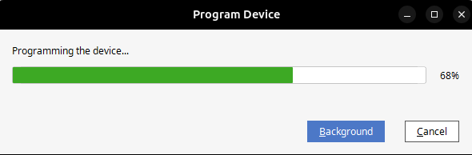
FPGA Configuration: Loading Bitstream via Vivado GUI
shakti.org.in
‹#›

Slide 18
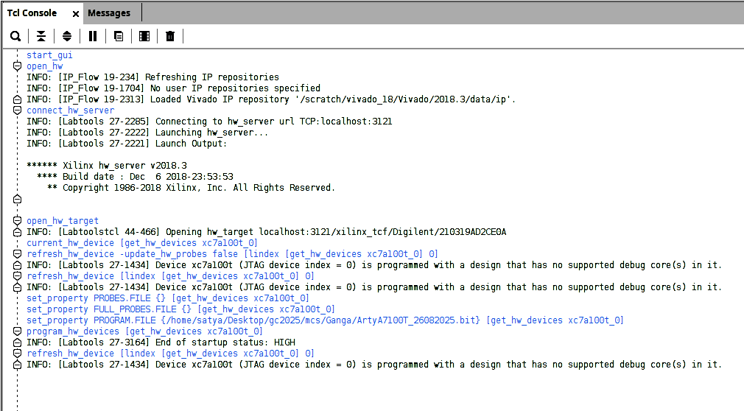
FPGA Configuration: Loading Bitstream via Vivado GUI
shakti.org.in
‹#›

Slide 19
FPGA Configuration: Loading MCS via Vivado GUI
shakti.org.in
‹#›

Slide 20
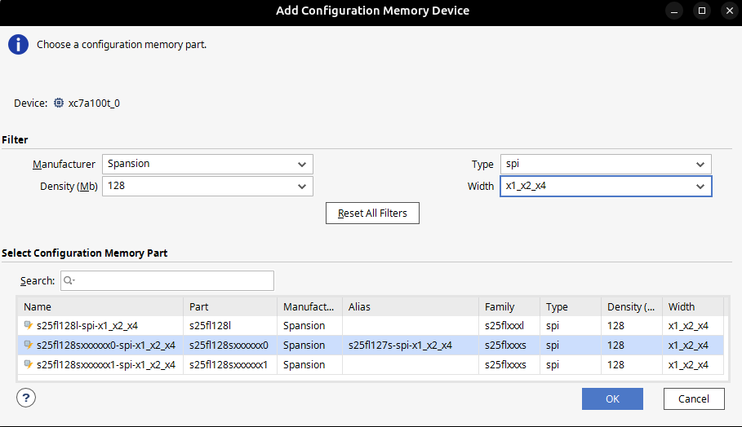
FPGA Configuration: Loading MCS via Vivado GUI
shakti.org.in
‹#›

Slide 21
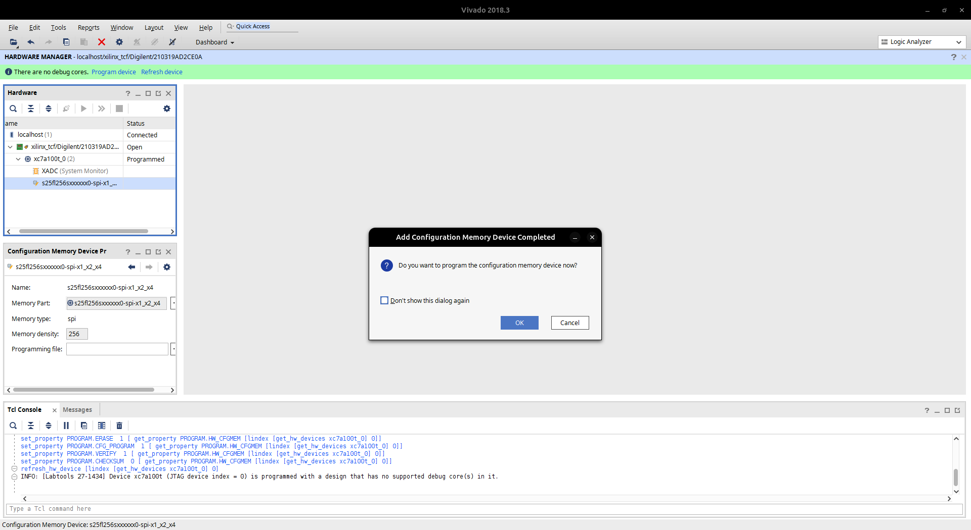
FPGA Configuration: Loading MCS via Vivado GUI
shakti.org.in
‹#›

Slide 22
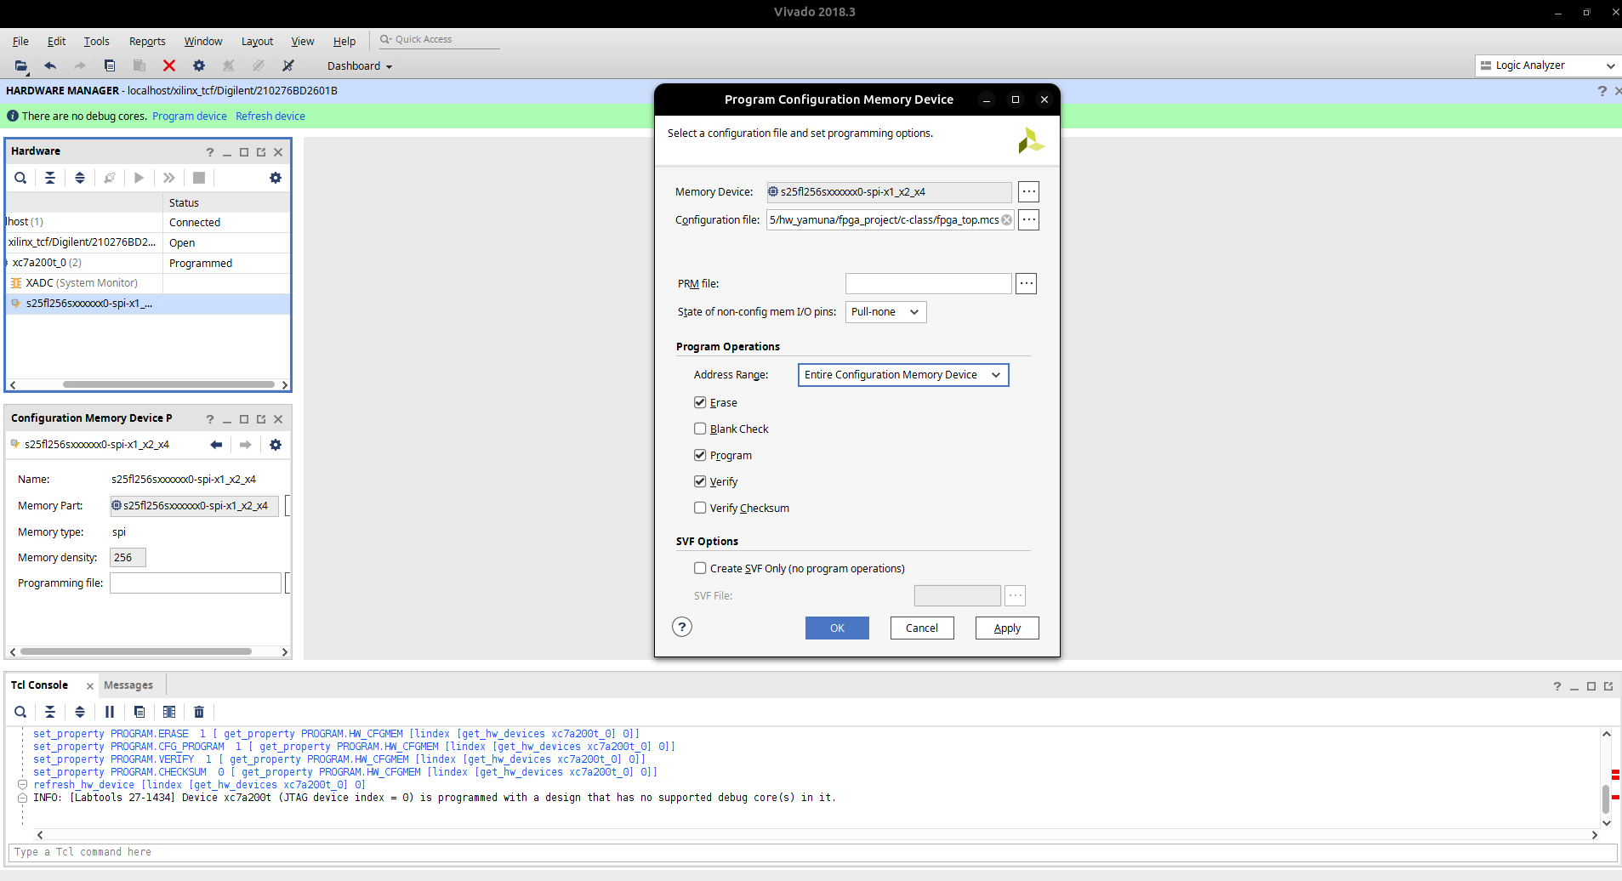
FPGA Configuration: Loading MCS via Vivado GUI
shakti.org.in
‹#›

Slide 23
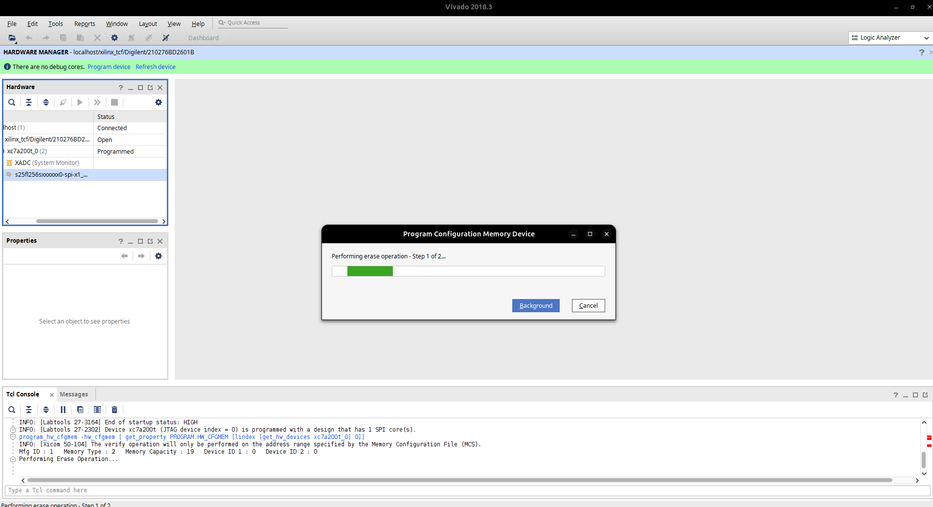
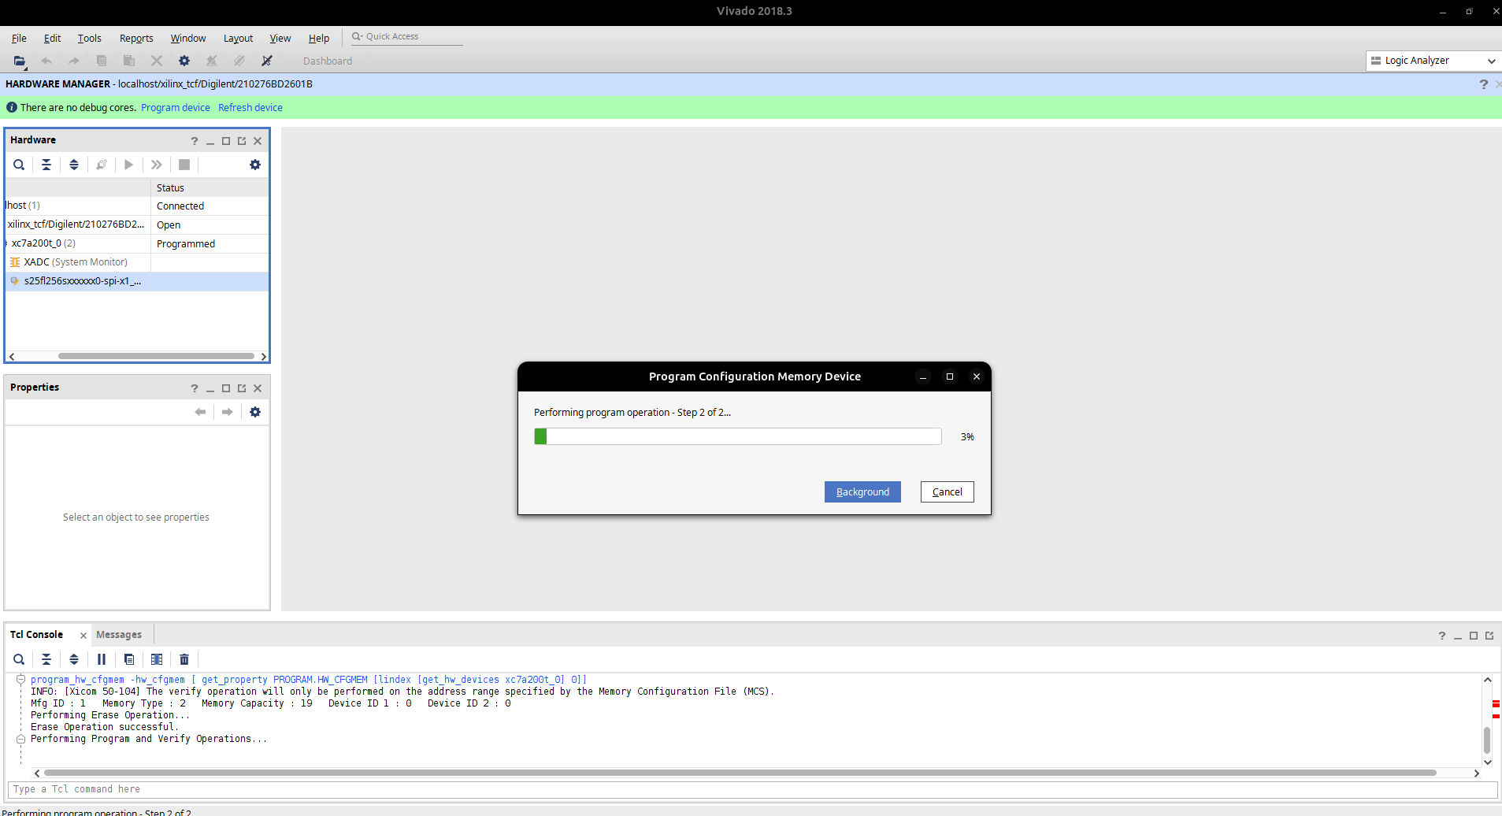
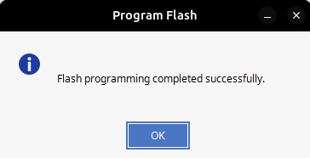
FPGA Configuration: Loading MCS via Vivado GUI
shakti.org.in
‹#›

Slide 24
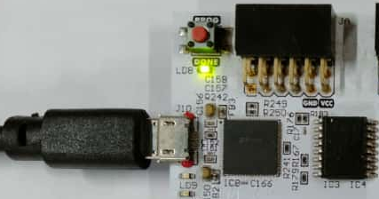
FPGA Configuration: Status Check
shakti.org.in
‹#›

Slide 25
Queries ?

Slide 26
Thank You !

